Slide 1

TRAVEL DESTINATION
BOOKING SYSTEM

Slide 2

Travel Destination Booking System
Group No: 6
Group members:
YASH KAIN (18-BCA-095)
VINAY VINCENT (18-BCA-110)
BIJESH THOMAS (18-BCA-156)
Internal guide:
MS. CECIL JOHNY
External guide:
Jugal Prajapati

Slide 3


INDEX
COMPANY INTRODUCTION
INTRODUCTION OF THE PROJECT
REQUIREMENT GATHERING
EXISTING SYSTEM
NEW SYSTEM
TOOLS AND TECHNOLOGY
CONTEXT LEVEL
LEVEL 1

Slide 4
1.
Company Introduction
Aarnik
Technology……..

Slide 5

Company Introduction
Aarnik Technology, as a website development company that holds a reputed image among our contemporaries. They assure best services to clients for all the work related to website development. Website Development by their firm is completely original and unique. They have professionals working for the client’s website development projects that are relied upon them.
Their Roadmap starts with the mission, which is enduring. Aarnik Technology has always been delivering the most revolutionary and at the same time, powerful and well-timed solutions in website development
Client satisfaction is found very convenient and they care for the trust that our clients have in us and so we assure you to keep our quality up to the mark.

Slide 6






Services provided by company:
Website Development
Mobile App Development
Custom Development
Digital Marketing
Graphics Designing
ERP Software Development

Slide 7

Contact Details
Address: K-7,Shree Krishna Center Above Crossword Library Mithakhali Six Road, Navrangpura, Ahmedabad, Gujarat, India – 380009
Contact number: (+91) 99786 21654
Email ID: info@akashsir.com
Website: https://www.akashsir.com

Slide 8
2.
Project Introduction
Travel Destination
Booking System……..

Slide 9

Introduction Of The Project
We are going to develop a web application on Travel destination booking system.
The objective of this project is to develop a system that automates the processes and activities of a travel agency.
The purpose is to design a system using which one can perform all operations related to travelling.
The project has its unique features for the users.
Considering the present situation of the travel system, who face difficulties in finding their suitable packages, the idea of this system was brought.
It’s a system where user can explore options of their wish as per their request and come up with their own packages.

Slide 10
3.
Requirement Gathering
The
Entities……..

Slide 11

Requirement Gathering
There are five entities in our system, that are: Admin, Visitor, Traveler, Hotel and Agency.
Visitor, Hotels and Agencies can register themselves into the system.
All users can login into the system.
Admin will manage the details of travelers, hotels and agencies.
Visitor can see all the packages.
Traveler can search for pre defined packages
Traveler can perform booking and payment.
Hotel and Agency will update their booking status.

Slide 12
4.
Existing System
The Existing
System……..

Slide 13

Existing System
There is no such system available in the internet like ours, though some fractions of features has been taken from websites like www.makemytrip.com and www.redbus.com
In present situation customer face difficulty in finding the proper package for themselves because the predefined and fixed package availability.
In present system a customer has to approach various agencies to find details of places and to book tickets.
Processes are done automatically as well as manually, which is the key feature of our system.

Slide 14
5.
New System
The New
System……..

Slide 15
New System
The aim of the proposed system is to design a system using which one can perform all operations related to travelling.
The user register their details and is allowed to choose package according to his/her needs.
Traveler can create a package as per his/her wish.
There will be transparency throughout the system.
The proposed system will reduce the physically done activities of both the traveler and the Agency/Hotel.

Slide 16

New System(Admin)
Admin can login.
Admin will be managing the database.
Admin will be categorizing the registered entities as per their fields.
Admin will let the traveler select packages as per their needs.
Admin can manage the details of the traveler.
Admin can manage the details of the Agencies.
Admin can manage the details of the Hotels.
Admin will manage feedbacks the users.
Admin will manage complaints by the users.

Slide 17

New System(Visitor)
Visitor can view packages defined in the system.
Visitor can view the feedback.
Visitor can search for Hotels and agencies.
Visitor can register to the system after full acknowledgement.

Slide 18

New System(Traveler)
Traveler can login.
Traveler can search for packages.
Traveler even can create his/her own package.
Traveler can perform booking task by entering the respective data.
Traveler can confirm and perform payment transaction.

Slide 19

New System(Hotel)
Hotel can register themselves to the system.
Hotel can login.
Hotel will share details to the admin.
Hotel can share booking status to the traveler.
Hotel can share payment status to the traveler.

Slide 20

New System(Agency)
Agency can register themselves to the system.
Agency can login.
Agency will share details to the admin.
Agency can share booking status to the traveler.
Agency can share payment status to the traveler

Slide 21
6.
Tools & Technology
Tools & Tech. used
in our System……..

Slide 22




Tools And Technology
Platform:
Front End: Django 3.1 (Python)
Backend: MySQL
Other Tools:
Presentation tool: Microsoft Power Point 2019
Drawing tool: Edraw Max

Slide 23
7.
Context Level
In this
DFD……..

Slide 24
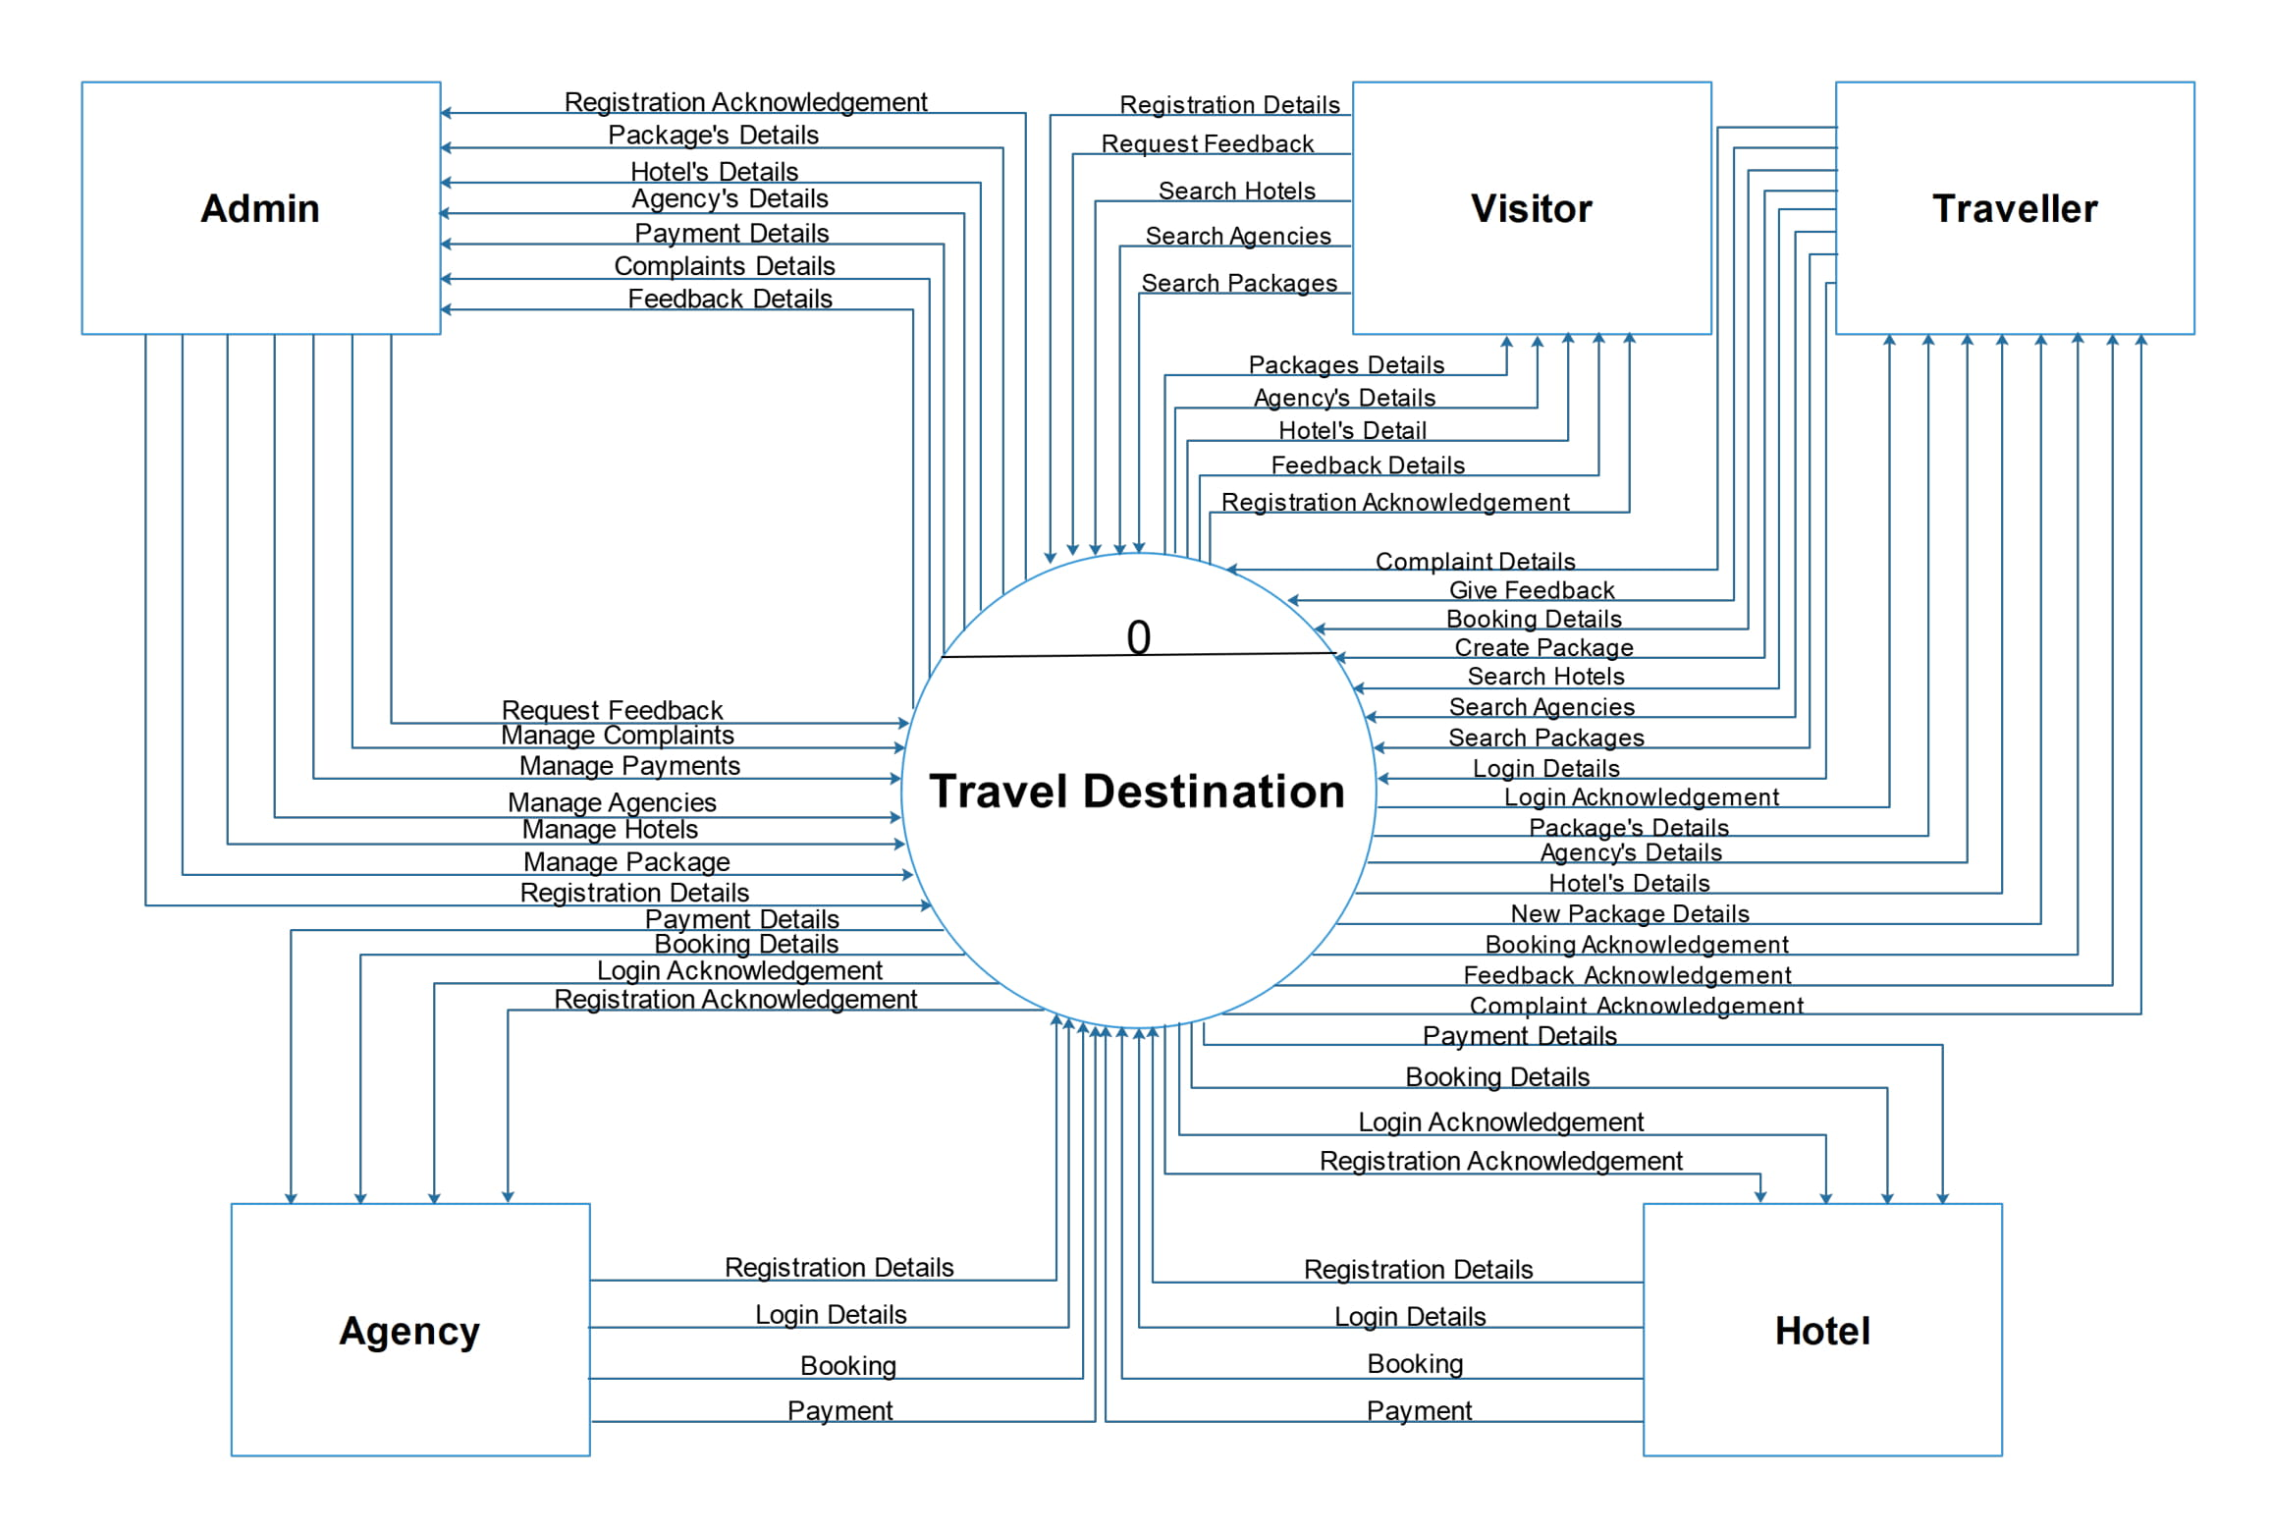

Slide 25
8.
Level 1
In this
DFD……..

Slide 26
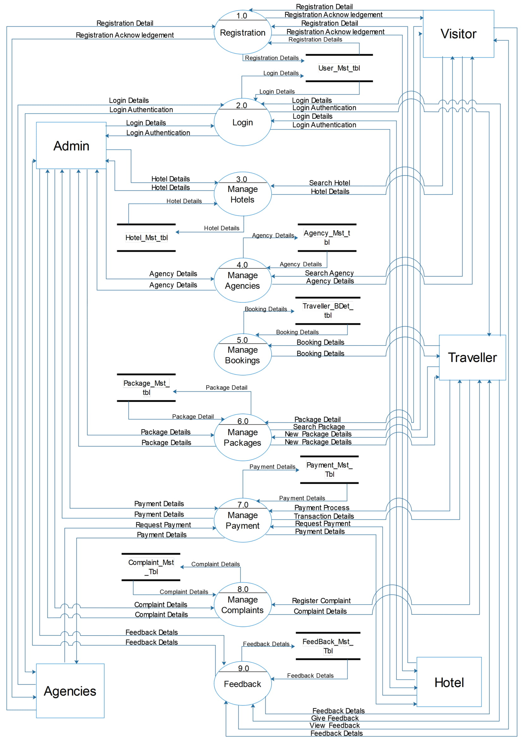

Slide 27
Thanks!
Any questions?
You can find us at kainyash@gmail.com, vinayvincent15 @gmail.com & bijesht4 @gmail.com

